Slide 1
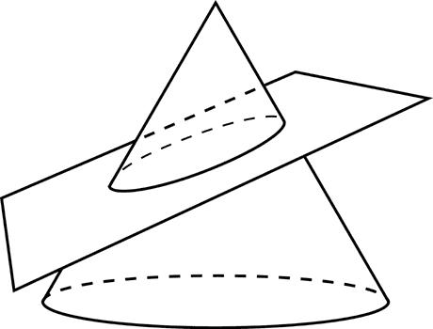
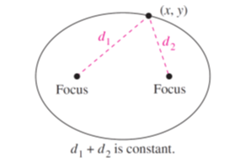
Ellipse
Review: The geometric definition relies on a cone and a plane intersecting it
Algebraic definition: a set of points in the plane such that the sum of the distances from two fixed points, called foci, remains constant.

Slide 2
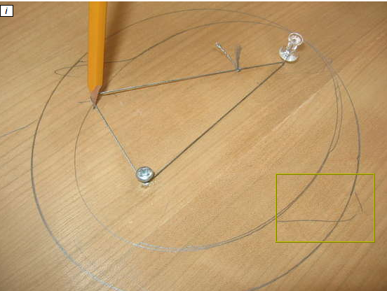
Hands-on Activity
At your table is paper, corkboard, string, and tacks.
Notes:
Teachers often demonstrate. If possible, have students do the activity. When students draw the conic themselves, they better understand the concept that the sum of the distances remains constant.

Slide 3
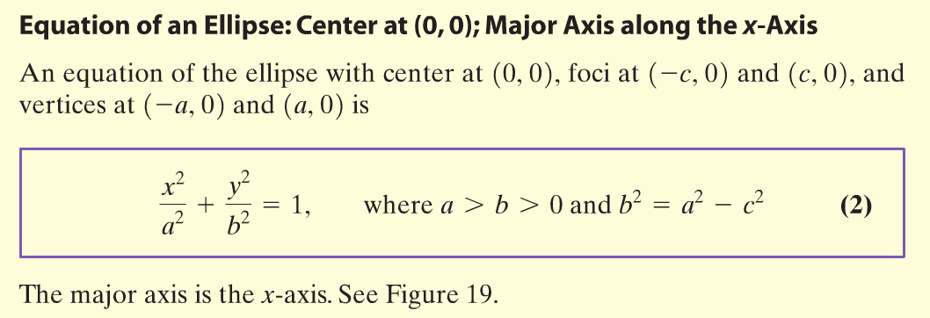
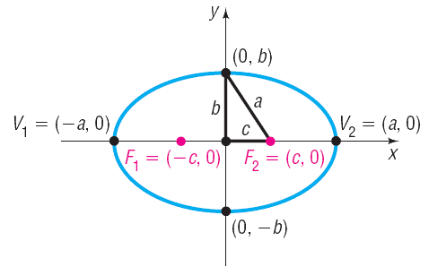

Slide 4
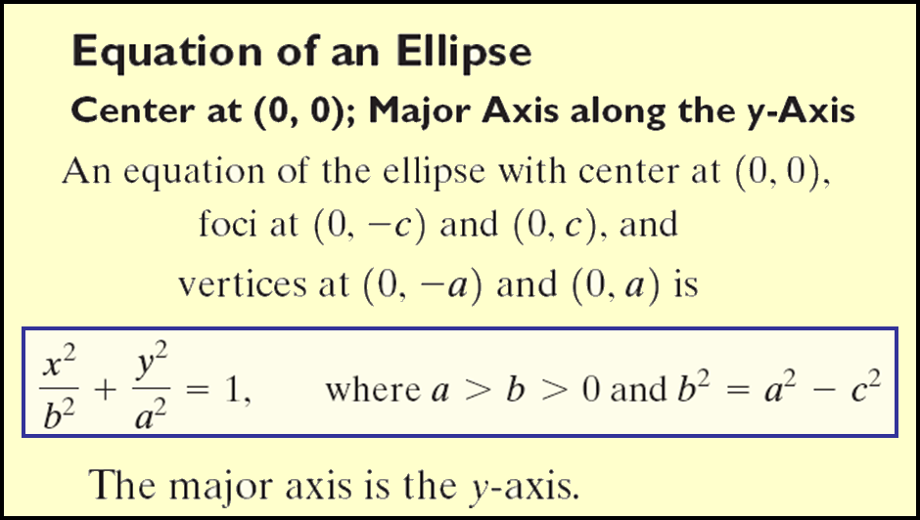
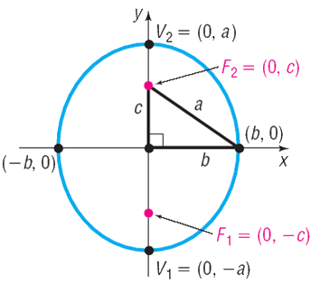

Slide 5
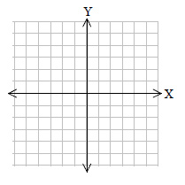











Example
Find the vertices for the major and minor axes, and the foci using the following equation of an ellipse.
$$\frac{x^{2}}{25}+\frac{y^{2}}{9}=1$$
Major axis is along the x-axis
Vertices of major axis:
$$a^{2}=25$$
$$a=±5$$
$$\left(−5,0\right) and (5,0)$$
Vertices of the minor axis
$$b^{2}=9$$
$$b=±3$$
$$\left(0,3\right) and (0,−3)$$
•
Foci
•
•
•
•
$$c^{2}=a^{2}−b^{2}$$
$$c^{2}=25−9$$
$$c^{2}=16$$
$$c=±4$$
•
$$\left(−4,0\right) and (4,0)$$

Slide 6
where the center is at (h, k) and |2a | is the length of the horizontal axis and |2b| is the of the length of the vertical axis.
Standard equation of Ellipse
In order to draw the graph Plot the center (h, k)
Plot the endpoints of the horizontal axis by moving “a” units left and right
from the center.
Plot the endpoints of the vertical axis by moving “b” units up and down from the
center.
Connect endpoint of axes with smooth curve.
Notes:
Explain how this should make sense to the students intuitively and not be something they memorize.
Since “X” is the horizontal axis, it should make sense the we would have the horizontal axis under it. Since “Y” is the vertical axis, it should make sense that we would have the vertical axis under it.

Slide 7
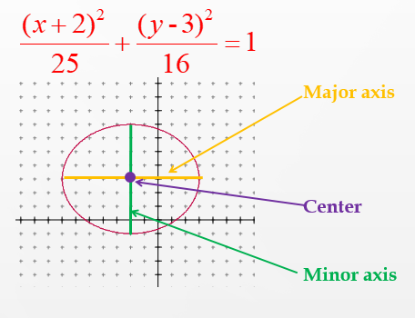


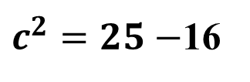


Example 2
Vertices of major axis:
$$\left(−5,0\right) and (5,0)$$
Vertices of the minor axis
$$\left(0,4\right) and (0,−4)$$
Foci
$$c^{2}=a^{2}−b^{2}$$
$c^{2}=25−$16
$$\left(−3,0\right) and (3,0)$$

Slide 8
Real life applications of ellipse
The path of each planet is an ellipse with the Sun at one focus. In physics, this is known as Kepler's first law of planetary motion.
Whispering Gallery - If light or a sound wave emanates from one focus of a real-life ellipse, it will be reflected to the other focus.
Lithotripsy Treatments-It is process of treatment of kidney stones without surgery.

Slide 9
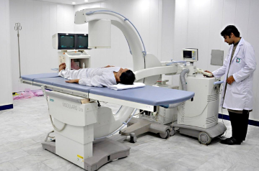
Lithotripsy Treatments

Slide 10
Example 3
The moon travels about Earth in an elliptical orbit with Earth at one focus, as shown . The major and minor axes of the orbit have lengths of 768,800 kilometers and 767,640 kilometers, respectively. Find the greatest and least distances (the apogee and perigee) from Earth’s center to the moon’s center.

Slide 11
Example 3-Solution
Because 2a = 768,800 and 2b = 767,640, you have
a = 384,400 and b = 383,820
which implies that c ≈ 21,108
So, the greatest distance between the center of Earth and the center of the moon is
a + c ≈ 384,400 + 21,108 = 405,508 km
and the least distance is
a – c ≈ 384,400 – 21,108 = 363,292 km

Slide 12
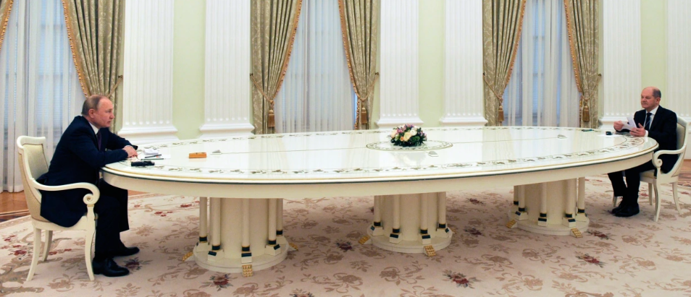
Vladimir Putin's meeting table

Slide 13
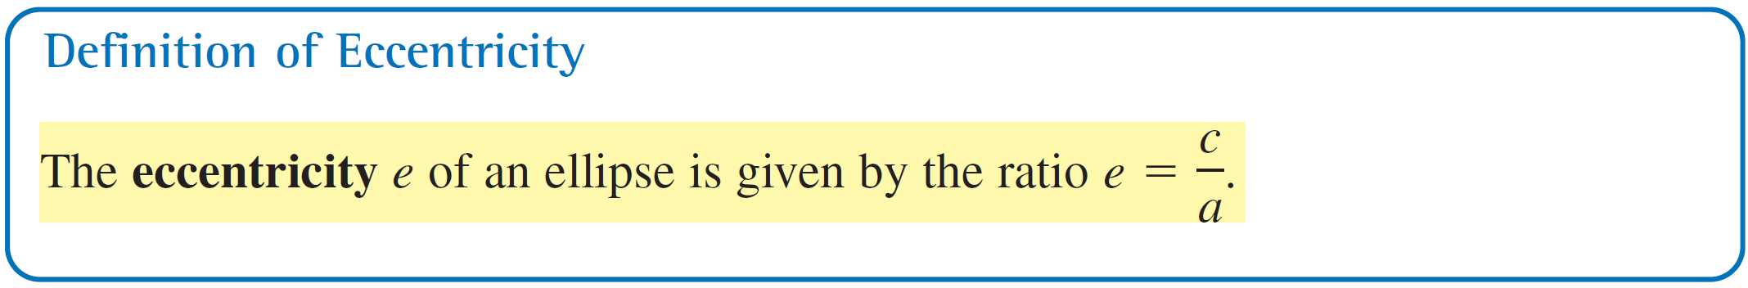
Eccentricity
To measure the ovalness of an ellipse, you can use the concept of eccentricity.
Note that 0 < e < 1 for every ellipse.

Slide 14

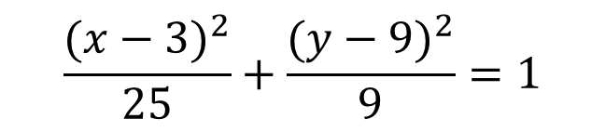
Practice
Find the center, vertices , and foci given the following equation of an ellipse.
$$\frac{{(x−3)}^{2}}{25}+\frac{{(y−9)}^{2}}{9}=1$$

Slide 15


Practice 2
Write the equation of the ellipse, sketch and find the foci, whose center is (4,-3), the major axis is vertical and has a length of 12, and the minor axis has a length of 8.

Slide 16
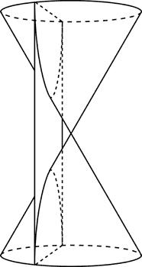
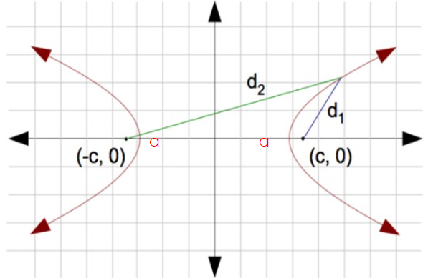
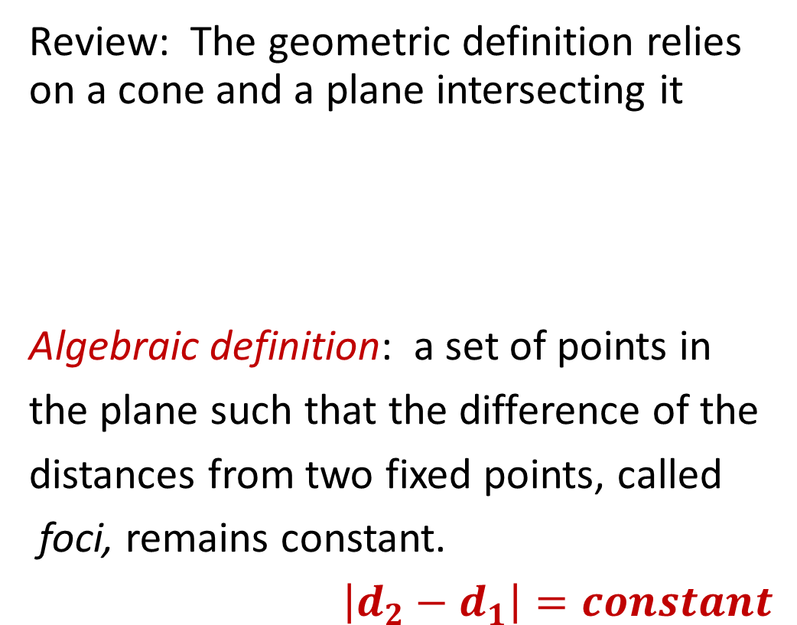
Hyperbola
Review: The geometric definition relies on a cone and a plane intersecting it
Algebraic definition: a set of points in
the plane such that the difference of the
distances from two fixed points, called
foci, remains constant.
$\left|d_{2}−d_{1}\right|=constant$

Slide 17
Items referenced on the graph of a hyperbola
Center
Transverse Axis
Conjugate Axis
Vertices
f₁
f₂
foci

Slide 18


Equation of hyperbola

Slide 19
Hyperbola Equation
Equation:
Compare the equations of ellipses and hyperbolas.
What makes the hyperbola different from a circle?
Notes:
When put it standard form the ellipse has a plus sign between the fractions (or before the variables) and the hyperbola has a minus sign between the fractions (or before ONE of the variables).
Stress that in the parabola equation, only one variable is squared, while two are squared in the circle, ellipse, and hyperbola equations.

Slide 20

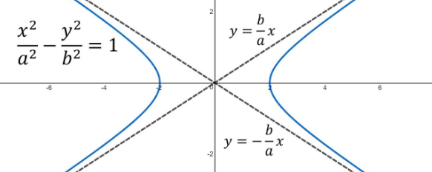
Asymptotes
The branches follow guide lines called asymptotes.

Slide 21
Example
Transverse axis
Conjugate axis
Center
Asymptotes
Notes:
Note: Tell students there should be arrows on the ends of the hyperbolas.

Slide 22

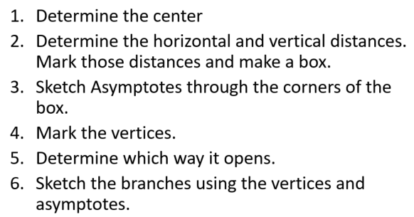

Slide 23
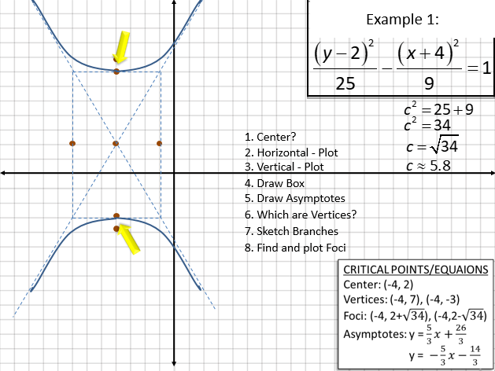


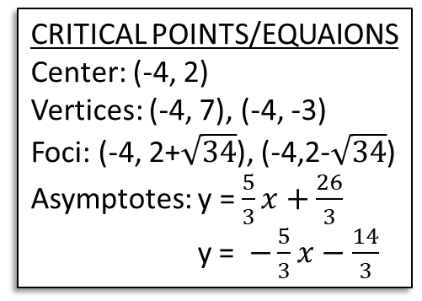
Example 1:
1. Center?
2. Horizontal - Plot
3. Vertical - Plot
4. Draw Box
5. Draw Asymptotes
6. Which are Vertices?
7. Sketch Branches
8. Find and plot Foci

Slide 24



Practice 3
Sketch the hyperbola
write the standard form of the equation of the hyperbola.

Slide 25

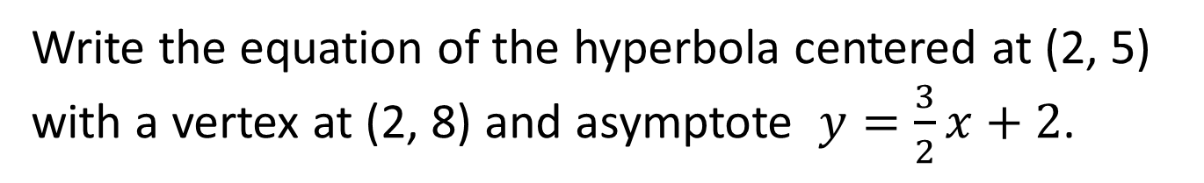
Practice 4
Write the equation in standard form and graph:
Write the equation of the hyperbola centered at (2, 5) with a vertex at (2, 8) and asymptote $y=\frac{3}{2}x+2$.

Slide 26
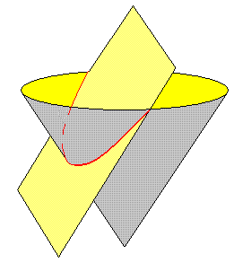
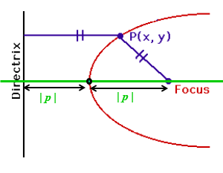
Parabola
Review: A parabola is the curve formed by the intersection of a plane and a cone, when the plane is at the same slant as the side of the cone.
Algebraic definition: All points that are equidistant from a given line (the directrix) and a fixed point not on the directrix (the focus)

Slide 27
The Standard Form of the Equation with Vertex (h, k)
For a parabola with an axis of symmetry parallel to the
x-axis and a vertex at (h, k), the standard form is:
(y - k)² = 4p(x - h)
The equation of the axis of symmetry is y = k.
The coordinates of the focus
are (h + p, k).
The equation of the directrix
is x = h - p.
When p is positive, the parabola
opens to the right.
When p is negative, the parabola
opens to the left.

Slide 28
The Standard Form of the Equation with Vertex (h, k)
For a parabola with the axis of symmetry parallel to
the y-axis and vertex at (h, k), the standard form is …
(x - h)² = 4p(y - k)
The equation of the axis of symmetry is x = h.
The coordinates of the focus are (h, k + p).
The equation of the directrix
is y = k - p.
When p is positive,
the parabola opens upward.
When p is negative,
the parabola opens downward.

Slide 29
Example: Graph (y + 3)² = -4(x – 2)
To graph:
1. Put in standard form
Done
2. Decide which way the parabola opens.
Left because x is on the right and 4 is negative
3. Plot the vertex (h,k)
(2,-3)
4. Plot the focus:
(1,-3): found by moving left 1 from the vertex
5. Draw the directrix:
x = 3: found by moving right 1 from the vertex
Notes:
Graph parabola on the board as you go through the steps.

Slide 30
Example: Graph (y + 3)² = -4(x – 2)
Vertex: (2,-3)
Focus: (1,-3)
Directrix: x = 3
L.R.: 4
Axis: y = -3

Slide 31
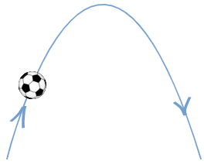
Applications of parabola
When you kick a soccer ball (or shoot an arrow, fire a missile or throw a stone) it arcs up into the air and comes down again

Slide 32
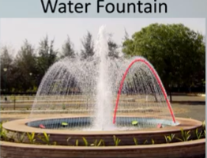
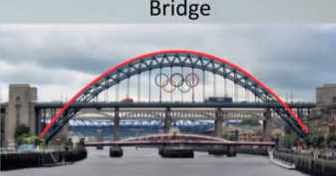
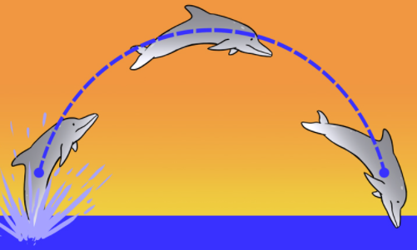
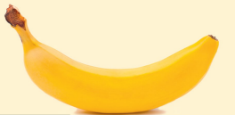

Slide 33
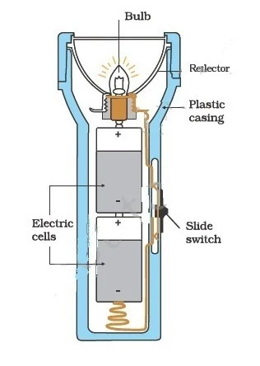
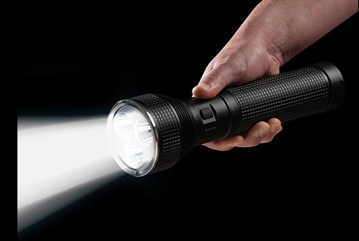
Applications of parabola

Slide 34
Practice 5
Find the coordinates of the vertex and focus,
the equation of the directrix, the axis of symmetry,
and the direction of opening of 2x² + 4x - 2y + 6 = 0.
Write the equation of the parabola with a focus at (3, 5) and
the directrix at x = 9
Given the following information, write the equation of the parabola.
Vertex is (0,0) and Focus is at (0,2)

